Slide 1
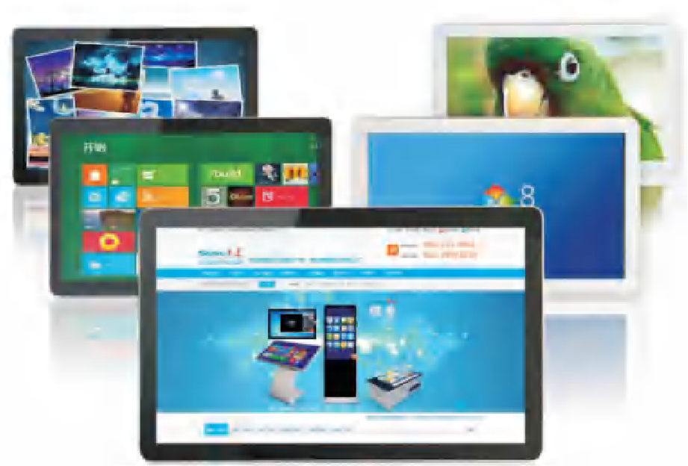
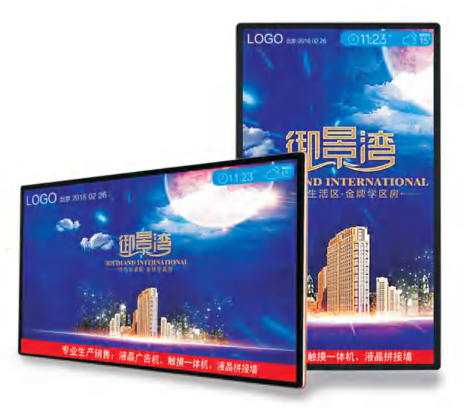
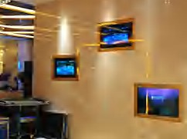
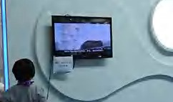
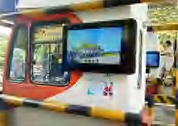
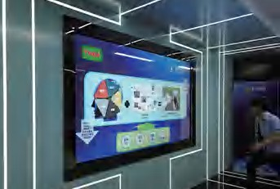
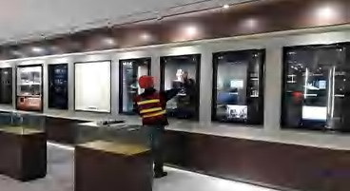
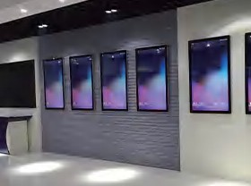
DIGITAL SIGNAGE SERIES ·MINI DIGITAL SIGNAGE
DIGITAL SIGNAGE SERIES ·WALL MOUNT DIGITAL SIGNAGE
MINI DIGITAL SIGNAGE
WALL MOUNT DIGITAL SIGNAGE
Machine Specifications:
Item: MINI Digital Signage Brand: GEO
Model: GEO-MDS
Body Material: Metal Plate/Aluminum Alloy Frame (Painting) Body Color: Silver, Gold, Black (Support customized) Frame Decoration: 5mm Tempered Glass (Black edgings) Packaging: Honeycomb Box+Foam
Installation: Wall Mount
Panel Size: 15”/15.5”/17”/18.5”/19”/21.5”/23.6”/27”
Matching System Solutions:
Solution1: Stand-alone Version
Plug the SD Card/U Disk in the Machine to Play Programs Solution2: Android System Version
A20+1G+4G/RK3288+2G+16G/RK3399+2G+16G
Playing Programs through the Machine of Android Network System Solution3: Windows System Version
CPU I3/I5/I7/I9+DDR3 4G/8G+SSD 32G/64G/128G/256G(HDD 500G/1T )
Playing Programs through the Machine of Windows Network System
Touch Screen Solutions:
Solution1: 10-points Capacitive Screen Touch Screen Solution2: 10-points Infrared Screen Touch Screen Solution3: 10-points Infrared Screen Touch Screen
Characters:
Playing Advertisement.
Applications:
Our Equipment is Widely Used in Cities, Government Buildings, Commercial Buildings, Transportation Scenes, Banks, CBD, Entertainment Scenes, Hospitals, Schools and Other Scenes.
Machine Specifications:
Item: Wall Mount Digital Signage
Brand: GEO Model: GE-WDS
Body Material: Metal Plate/Aluminum Alloy Frame (Painting) Body Color: Silver, Gold, Black (Support customized) Frame Decoration: 5mm Tempered Glass (Black edgings) Packaging: Honeycomb Box+Foam
Installation: Wall Mount
Panel Size: 21.5”/23.6”/27”/32”/43”/49”/55”/65”/70”/75”/80”/86”/98”/100
Matching System Solutions:
Solution1: Stand-alone Version
Plug the SD Card/U Disk in the Machine to Play Programs Solution2: Android System Version
A20+1G+4G/RK3288+2G+16G/RK3399+2G+16G
Playing Programs through the Machine of Android Network System Solution3: Windows System Version
CPU I3/I5/I7/I9+DDR3 4G/8G+SSD 32G/64G/128G/256G(HDD 500G/1T )
Playing Programs through the Machine of Windows Network System
Touch Screen Solutions:
Solution1: 10-points Capacitive Screen Touch Screen Solution2: 10-points Infrared Screen Touch Screen Solution3: 10-points Infrared Screen Touch Screen
Characters:
Playing Advertisement.
Applications:
Our Equipment is Widely Used in Cities, Government Buildings, Commercial Buildings, Transportation Scenes, Banks, CBD, Entertainment Scenes, Hospitals, Schools and Other Scenes.

Slide 2
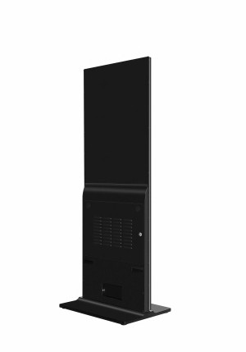
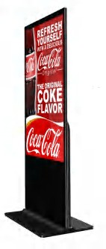
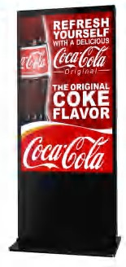
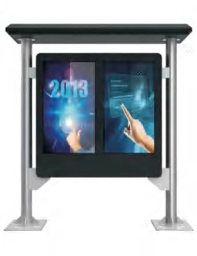
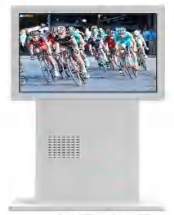
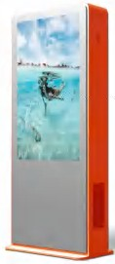
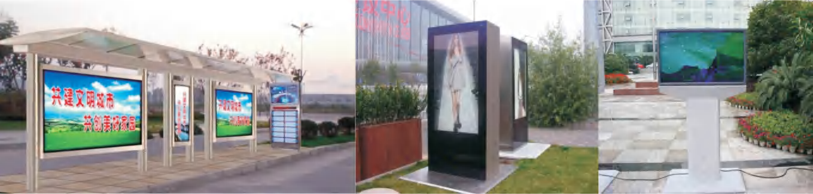
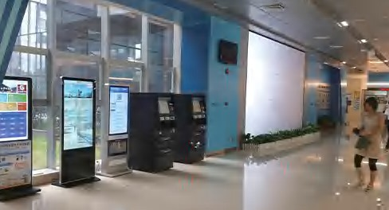
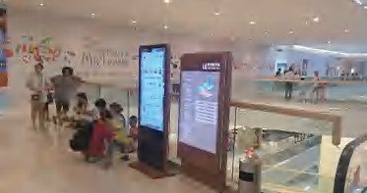
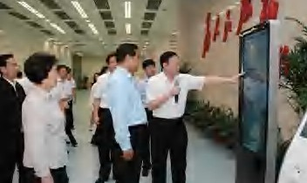
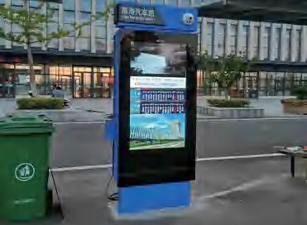
DIGITAL SIGNAGE SERIES ·STAND FLOOR DIGITAL SIGNAGE
DIGITAL SIGNAGE SERIES ·OUTDOOR DIGITAL SIGNAGE
STAND FLOOR DIGITAL SIGNAGE
OUTDOOR DIGITAL SIGNAGE
Machine Specifications:
Item: Outdoor Digital Signage Brand: GEO
Model: GEO-ODS
Body Material: Metal Plate/Aluminum Alloy Frame (Painting) Body Color: Silver, Gold, White, Black (Support customized) Frame Decoration: 5mm Tempered Glass (Black edgings) Packaging: Honeycomb Box+Foam
Installation: Wall Mount/Stand Floor
Panel Size: 43”/49”/55”/65”/70”/75”/86”/98”
Expanding Functions: Grade IP65/Waterproof/Dust-Proof/Wet-Proof/Corrosion-Proof/Force-Proof/ Anti-Glare/Automatically Adjust Brightness/Temperature Control System/Air Cooling/Air Conditioner
Matching System Solutions:
Solution1: Stand-alone Version
Plug the SD Card/U Disk in the Machine to Play Programs Solution2: Android System Version
A20+1G+4G/R K3288+2G+16G/RK3399+2G+16G
Playing Programs through the Machine of Android Network System Solution3: Windows System Version
CPU I3/I5/I7/I9+DDR3 4G/8G+SSD 32G/64G/128G/256G(HDD 500G/1T )
Playing Programs through the Machine of Windows Network System
Touch Screen Solutions:
Solution1: Display Screen and None Touch Solution2: 10-points Capacitive Screen Touch Screen Solution3: 10-points Infrared Screen Touch Screen
Characters:
Playing Advertisement.
Applications:
Our Equipment is Widely Used in Cities, Government Buildings, Commercial Buildings, Transportation Scenes, Banks, CBD, Entertainment Scenes, Hospitals, Schools and Other Scenes.
Machine Specifications:
Item: Stand Floor Digital Signage Brand: GEO
Model: GEO-SDS
Body Material: Metal Plate/Aluminum Alloy Frame (Painting) Body Color: Silver, Gold, Black (Support customized) Frame Decoration: 5mm Tempered Glass (Black edgings) Packaging: Honeycomb Box+Foam
Installation: Stand Floor
Panel Size: 32”/43”/49”/55”/65”/70”/75”/86”
Matching System Solutions:
Solution1: Stand-alone Version
Plug the SD Card/U Disk in the Machine to Play Programs Solution2: Android System Version
A20+1G+4G/R K3288+2G+16G/RK3399+2G+16G
Playing Programs through the Machine of Android Network System Solution3: Windows System Version
CPU I3/I5/I7/I9+DDR3 4G/8G+SSD 32G/64G/128G/256G(HDD 500G/1T )
Playing Programs through the Machine of Windows Network System
Touch Screen Solutions:
Solution1: Display Screen and None Touch Solution2: 10-points Capacitive Screen Touch Screen Solution3: 10-points Infrared Screen Touch Screen
Characters:
Playing Advertisement.
Applications:
Our Equipment is Widely Used in Cities, Government Buildings, Commercial Buildings, Transportation Scenes, Banks, CBD, Entertainment Scenes, Hospitals, Schools and Other Scenes.

