Slide 1
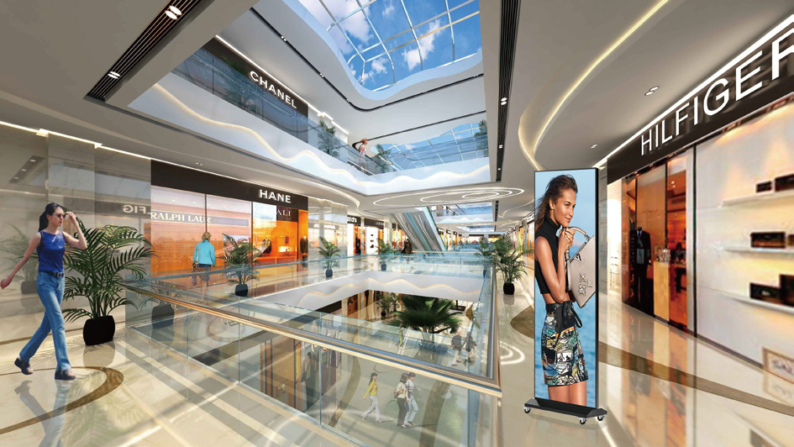
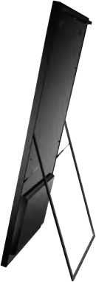
Gposter Series
Gposter(P1.8/P2/P2.5/P3.07/P4
FEATURES
Multiple installation ways: hanging, wall-mounting, base-standing, bracket standing and creative installation
High brightness, high refresh rate, 160° viewing angle, a much better replacement of LCD screen
Can be controlled by mobile phone/computer/Wi-Fi /USB connection
Better replacement of traditional roll screen
SPECIFICATIONS
Product | P1.82 | P2 | P2.5 | P3.07 | P4
Pitch | 1.82mm | 2mm | 2.5mm | 3.07mm | 4mm
Resol ution(dots) | 352*1056 | 320*960 | 256*768 | 208*624 | 160*480
LED Type | SMD1515 |  | SMD2121
Brightness | 1000nits |  | 1200nits
Module Size | 320*160mm
Total Poster Size | W655mm*H1936mm*T45mm
LED Size | W640*H1920mm
Material | Acrylic + Aluminum
Weight | 35 kg/pcs
Control Method | 4G/Wifi/Ethernet+Cloud Cluster Control+Mobile App
Protection Level | IP40
Cabinet Maintenance | Front &Rear Service
Max Power Consumption | 700W
Average Power Consumption | 250W
Refresh Rate (Hz) | 2880-3840HZ
Grey Scale | 16 bit
Viewing Angle | H160°, V160°
Voltage | AC100~240V(50-63Hz)
Working Temperature | -40°C-+70°C
Working Humidity | 10%-90%RH
Color Temperature | 6500-9500K
Brightness Sensor | 0-255 level automatic adjustment, optional
Contrast Ratio | 4000:01:00
Certifications | EMC/CE/ROHS/CCC/FCC/ISO

Slide 2
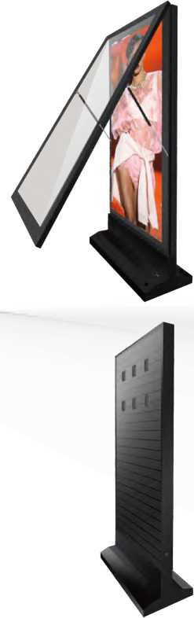
Gposter Series
Gposter(P1.8/P2/P2.5/P3.07/P4)
FEATURES
Multiple installation ways: floor-standing,pillar-mounting, hanging,etc
Can be controlled by mobile phone /computer/Wi-Fi/3G/4G/Cloud-clu stered-control
Precision advertising with face recognition function
Enough space for inside sound system
Remote control for the power switch
Brightness sensor for automatic brightness adjustment
Optional bottom wheels
Compatible with HD camera for monitoring
SPECIFICATIONS
 | Indoor |  | Outdoor
Product | P1.875 | P2 | P2.5 | P3 | P4
Pitch | 1.875mm | 2mm | 2.5mm | 3mm | 4mm
Resol ution(dots) | 512*1024 | 480*960 | 384*768 | 320*640 | 240*480
LED Type | SMD1515 |  | SMD1921
Brightness | 1000nits | 1000nits | 3500nits | 4500nits | 5500nits
Module Size | 240*240mm |  | 320*160mm
Total Poster Size | W1140*H2100*T210mm
LED Size | W960*H1920mm (Customizable)
Bottom Wheel | H27.5mm (Dismountable, optional)
Material | Tempered Glass + Galvanized Aluminum
Weight | 70kg/pcs
Control Method | 3G/4G/Wifi+Cloud Cluster Control+Mobile App
Protection Level | IP65
Cabinet Maintenance | Front&Rear Service
Max Power Consumption | 1200W |  | 1800W
Average Power Consumption | 400W |  | 600W
Refresh Rate (Hz) | 2880-3840HZ
Grey Scale | 16 bit
Viewing Angle | H160°, V160° |  | H160°, V140°
Voltage | AC100~240V(50-63Hz)
Working Temperature | -30°C - +80°C
Working Humidity | 10%-90%RH
ColorTemperature | 6500-9500K
Brightness Sensor | 0-255 level automatic adjustment, optional
Power Control | Remote power control, optional
Monitoring | HD camera, optional
Sound System | Power consumption 10-30W, optional
Enviroment Detection | Temperature/Humidity/PM2.5, optional
Certifications | EMC/CE/ROHS/CCC/FCC/ISO

