Slide 1
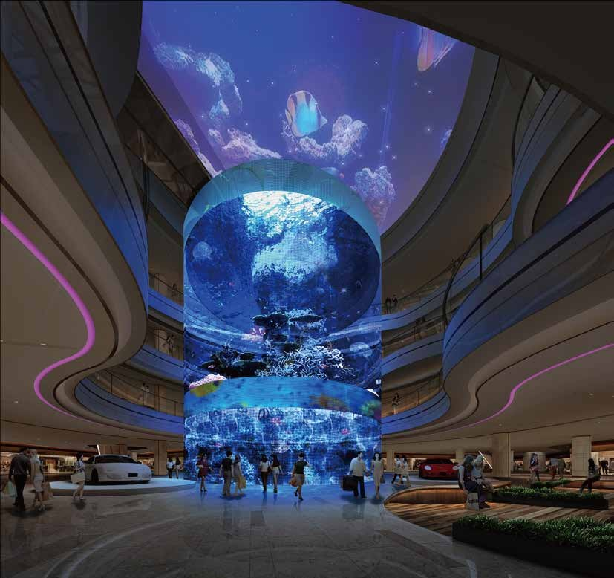
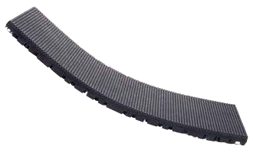
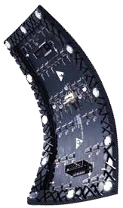
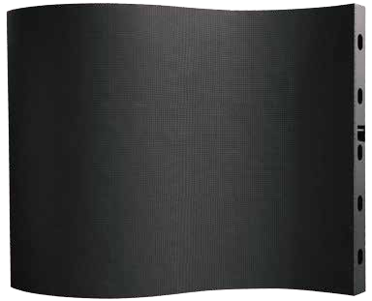
GFL Series
GFL(P1.2/P1.5/P1.6/P1.8/P2.5/P3/P4
FEATURES
Ultra Flexible;
Light Weight;
Seamless Connection;
Various installation shapes including
concave, convex, round, wave, S type, flat led screen
GFL Specification
Pixel Pitch（mm） | 1.25 | 1.56 | 1.667 | 1.875 | 2.5 | 3 | 4
Pixel Configuration | SMD1010 | SMD1010 | SMD1010 | SMD1515 | SMD2121 | SMD2121 | SMD2121
Pixel Density (dot/sqm) | 640000 | 410881 | 360000 | 284444 | 160000 | 111111 | 62500
Module pixel(W×H） | 160*120 | 128*96 | 120*90 | 128×64 | 96×48 | 80*40 | 64x32
Module Size(mm） | 200（W）*150（H） |  |  | 240（W）×120(H) |  |  | 256（W）×128(H)
Driving Model | 1/60 scan | 1/48 scan | 1/45 scan | 1/32 scan | 1/24 scan | 1/20 scan | 1/16 scan
Brightness (cd/ m2) | 600～800 adjustable
Viewing Angle | 140/140 (Horizontal /Vertical )
Power Consumption (max) (W/m²） | 620
Power Consumption (avg)（W/m²） | 200
Refresh Rate（Hz） | 1920-3840HZ
Signal Transmission Distance （m） | CAT5 cable:＜100 m; Single mode fiber:＜10 km
Storage Temperature（℃） | -30-70
Working Temperature (℃) | -20-65
IP rating (Front/Rear) | IP40/IP20
Storage Humidity (RH) | 10%~90% non-condensing
Working Humidity (RH) | 10%~60% non-condensing
Lifetime Typical Value（hrs） | 100000
Maintenance | Front

Slide 2
