Slide 1
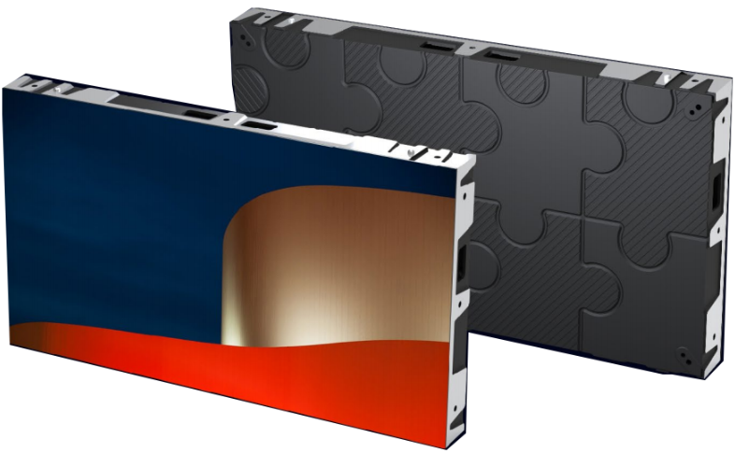
GMN Series
GMN(P0.9/P1.2/P1.5/P1.8
FEATURES
High Performance
Direct wall mounting
Front Installation, Front Maintenance
Full HD scale options
Multi pixel pitch for option
Popular cabinet size(W:H) : 16:9 / 600x337.5mm
40mm thickness
GMN Specification
Pixel Pitch（mm） | 0.9 | 1.2 | 1.5 | 1.8
Pixel Configuration | SMD 4-in-1 | SMD1010 | SMD1212 | SMD1515
Module Resolution | 320x180 | 240x135 | 192x108 | 160x90
Pixel density（pixels/sqm） | 1137778 | 640000 | 409600 | 284444
Cabinet Dimensions (WxHxD)/（mm） | 600x337.5x58
Module Dimensions (WxH)/（mm） | 300x168.75
Cabinet material | Die Casting Aluminum
Cabinet weight (kg/cabinet) | 5.8
Module weight (kg/cabinet) | 0.315
Driving Type | 1/46 | 1/45 | 1/48 | 1/45
Signal Transmission Distance （m） | CAT5 cable:＜100 m; Single mode fiber:＜10 km
Brightness（nits） | 350-400 | 500-600 | 500-600 | 500-600
Optimal Horizontal Viewing Angle（°） | 160°
Optimal Vertical Viewing Angle（°） | 160°
AC Input Voltage（V） | AC110-220V
Maximum Power consumpution (W/M2) | 450 | 450 | 450 | 450
Average Power consumpution (W/M2) | 135 | 135 | 135 | 135
Storage Temperature（℃） | -30℃~+70℃
Working Temperature (℃) | -20℃~+65℃
IP rating (Front/Rear) | IP40/IP20
Storage Humidity (RH) | 10%~90% non-condensing
Working Humidity (RH) | 10%~60% non-condensing
Cabinet installation | Fix

Slide 2
