Slide 1
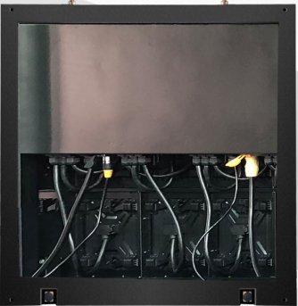
GLS Series
GLS(P3.9/P4.8/P5.2/P8/P10)
FEATURES
Double waterproof design
Ultra light and thin
Front&back mainteance
Highly customizable for outdoor fixed installation projects
Can be installed on the wall directly without a steel structure
90° angle design available
Great heat dissipation
SPECIFICATIONS
Product | P3.91 | P4.81 | P5.2 | P8 | P10(SMD) | P10(DIP)
Pitch | 3.91mm | 4.81mm | 5.2mm | 8mm | 10mm | 10mm
Density (pixels/m2) | 65536 | 43264 | 36868 | 15625 | 10000 | 10000
LED Type | SMD1921 |  | SMD2727 | SMD3535 |  | DIP346
Brightness | 5500nits | 5500nits | 6000nits | 6000nits | 6500nits | 7500nits
Scan Method | 1/8 | 1/7 | 1/6 | 1/5 | 1/2 | 1/4
Cabinet Size | Customized
Module Size | 250*250mm |  | 320*320mm
Cabinet Material | Aluminum
Cabinet Weight | 30kg/m2 |  |  |  |  | 40kg/m2
Protection Level | IP65
Cabinet Maintenance | 100% Front Service
Max Power Consumption | 650w/m2 | 650w/m2 | 650w/m2 | 650w/m2 | 650w/m2 | 550w/m2
Average Power Consumption | 220w/m2 | 220w/m2 | 220w/m2 | 220w/m2 | 220w/ms | 200w/m2
Refresh Rate (Hz) | 1920-840HZ
Grey Scale | 16 bit
Viewing Angle | H160°, V160° |  | H140°, V140° |  |  | H140°, V70°
Voltage | AC100~240V(50-63Hz)
Working Temperature | -30°C-+65°C
Working Humidity | 10%-90%RH
Color Temperature | 6500-9500K
Certifications | EMC/CE/ROHS/CCC/FCC/ISO/BIS

