Slide 1
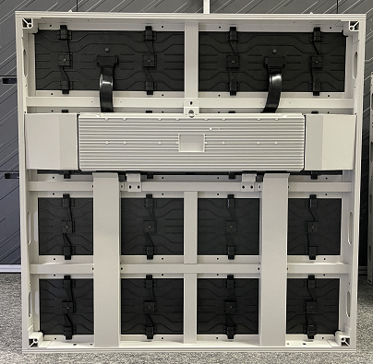
GPO Series
GPO(P3.9/P4.8/P5.2/P6.25/P7.8/P10.4)
FEATURES
Front and rear access, 3-seconds module disassembly with magnetic tool
2.8V&3.8V PCB design,based on SMD, can easily reach 10000nits,only need 450W/㎡
Module applies hard connection without flat cables, reducing failure rate while mproving stability
Aluminum profile cabinet owns high precision, ensuring the flatness of whole screen
Module is corner and flat screen 2 in 1 design, can make L shape corner cabinets
SPECIFICATIONS
Product Model | GPO3.9 | GPO4.8 | GPO5.2 | GPO6.25 | GPO7.8 | GPO10.4
Pixel Pitch(mm) | 3.91 | 4.81 | 5.2 | 6.25 | 7.82 | 10.4
LED Type | SMD
Scan method | 1/8 scan | 1/7 scan | 1/6 scan | 1/5 scan | 1/4 scan | 1/2 scan
Brightness(cd/m2) | ≥5000 (8000-10000) | ≥5500 (8000-10000) | ≥6000 (8000-10000) | ≥6000 (8000-10000) | ≥6000 (8000-10000) | ≥6500 (8000-10000)
Refresh Rate(Hz) | ≥ 1920Hz（3840HzOptional)
Power Consumption(Max/Ave) (W/m2) | 800/270 | 800/270 | 550/185 | 500/175 | 500/175 | 500/175
Module Resolution(px) | 128 x 64 | 104 x 52 | 96 x 48 | 80 x 40 | 64 x 32 | 48 x 24
Module Size(mm) | 500x250
Panel Resolution(px) | 256 x 256 | 208 x 208 | 192 x 192 | 160 x 160 | 128 x 128 | 96 x 96
Panel Size(mm) | 1000 x 1000 x 73mm (Optional)
Weight(kg/m2) | 24.5
IP Rating(Front/Rear) | IP67/IP65
Gray Scale(Bit) | 16
Maintenance | Front&Rear
Operating Temperature/Humidity(°C/RH) | -20-65 10〜90%

