Slide 1
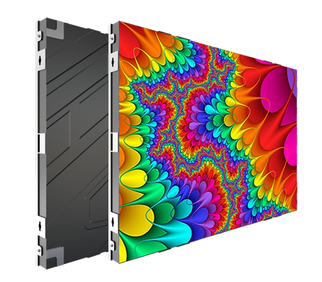
GPN Series
GPN (1.25/1.53/1.86/2/2.5/3.076/4)
FEATURES
High Performance
Direct wall mounting
Front Installation, Front Maintenance
Full HD scale options
Multi pixel pitch for option
Popular cabinet size(W:H) : 16:9 / 600x337.5mm
GPN Specification
Product Model | GPN1.2 | GPN1.5 | GPN1.8 | GPN2 | GPN2.5 | GPN3 | GPN4
Pixel Pitch(mm) | 1.25 | 1.538 | 1.86 | 2 | 2.5 | 3.076 | 4
Pixel Composition | SMD1010 | SMD1212 | SMD1515 | SMD1515 | SMD2020 | SMD2020 | SMD2121
Scan method | 1/64 scan | 1/52 scan | 1/43 scan | 1/40 scan | 1/32 scan | 1/26 scan | 1/20 scan
Brightness(cd/m2) | 600 | 600 | 600 | 600 | 800 | 800 | 800
Refresh Rate(Hz) | Support 3840
Power Consumption(Max/A ve) (W/m2) | 650/220 | 600/200 | 580/195 | 580/195 | 550/185 | 550185 | 600/200
Module Size/W×H(mm) | 320×160
Panel Size/W×H(mm) | 640 x 480 / 640 x 640 / 960 x 480 / 320 x 640
Panel Material | Die casting aluminum | Die casting aluminum | Die casting aluminum | Die casting aluminum | Die casting aluminum | Die casting aluminum | Die casting aluminum
Weight(kg/㎡) | 21
Power Requirement | AC 100-240V(50- 60Hz)
IP Rating (front/rear) | IP40/IP20
Viewing Angle(H/V) | 160°/160°
Gray Scale(Bit) | 16
Maintenance | Front
Working Temperature/Humidity(°C/RH) | -20-+65/10%- 90%
Storage Temperature/Humidity(°C/RH) | -30-+70/10%- 90%
Cabinet installation | Fixed

Slide 2
